Slide 1
Politics and Power
Dylan Andrade, Colleen Hackendahl, Caroline Jeranek, Emma Kienzle, Brendan McCusker, Lisa Montgomery

Slide 2
Theme
Following decades of control from the right or left, the American people struggled to create a political identity as the voting population identified itself somewhere in the middle of the political spectrum, thereby leaving the government to fight amongst itself and more radical wings of each party.

Slide 3



Overall Trends
Republicans / Democrats coming to power following a period of economic stability or success
Caution and paranoia intensified after the 9/11 attacks, and this led to the creation of the patriot act.

Slide 4
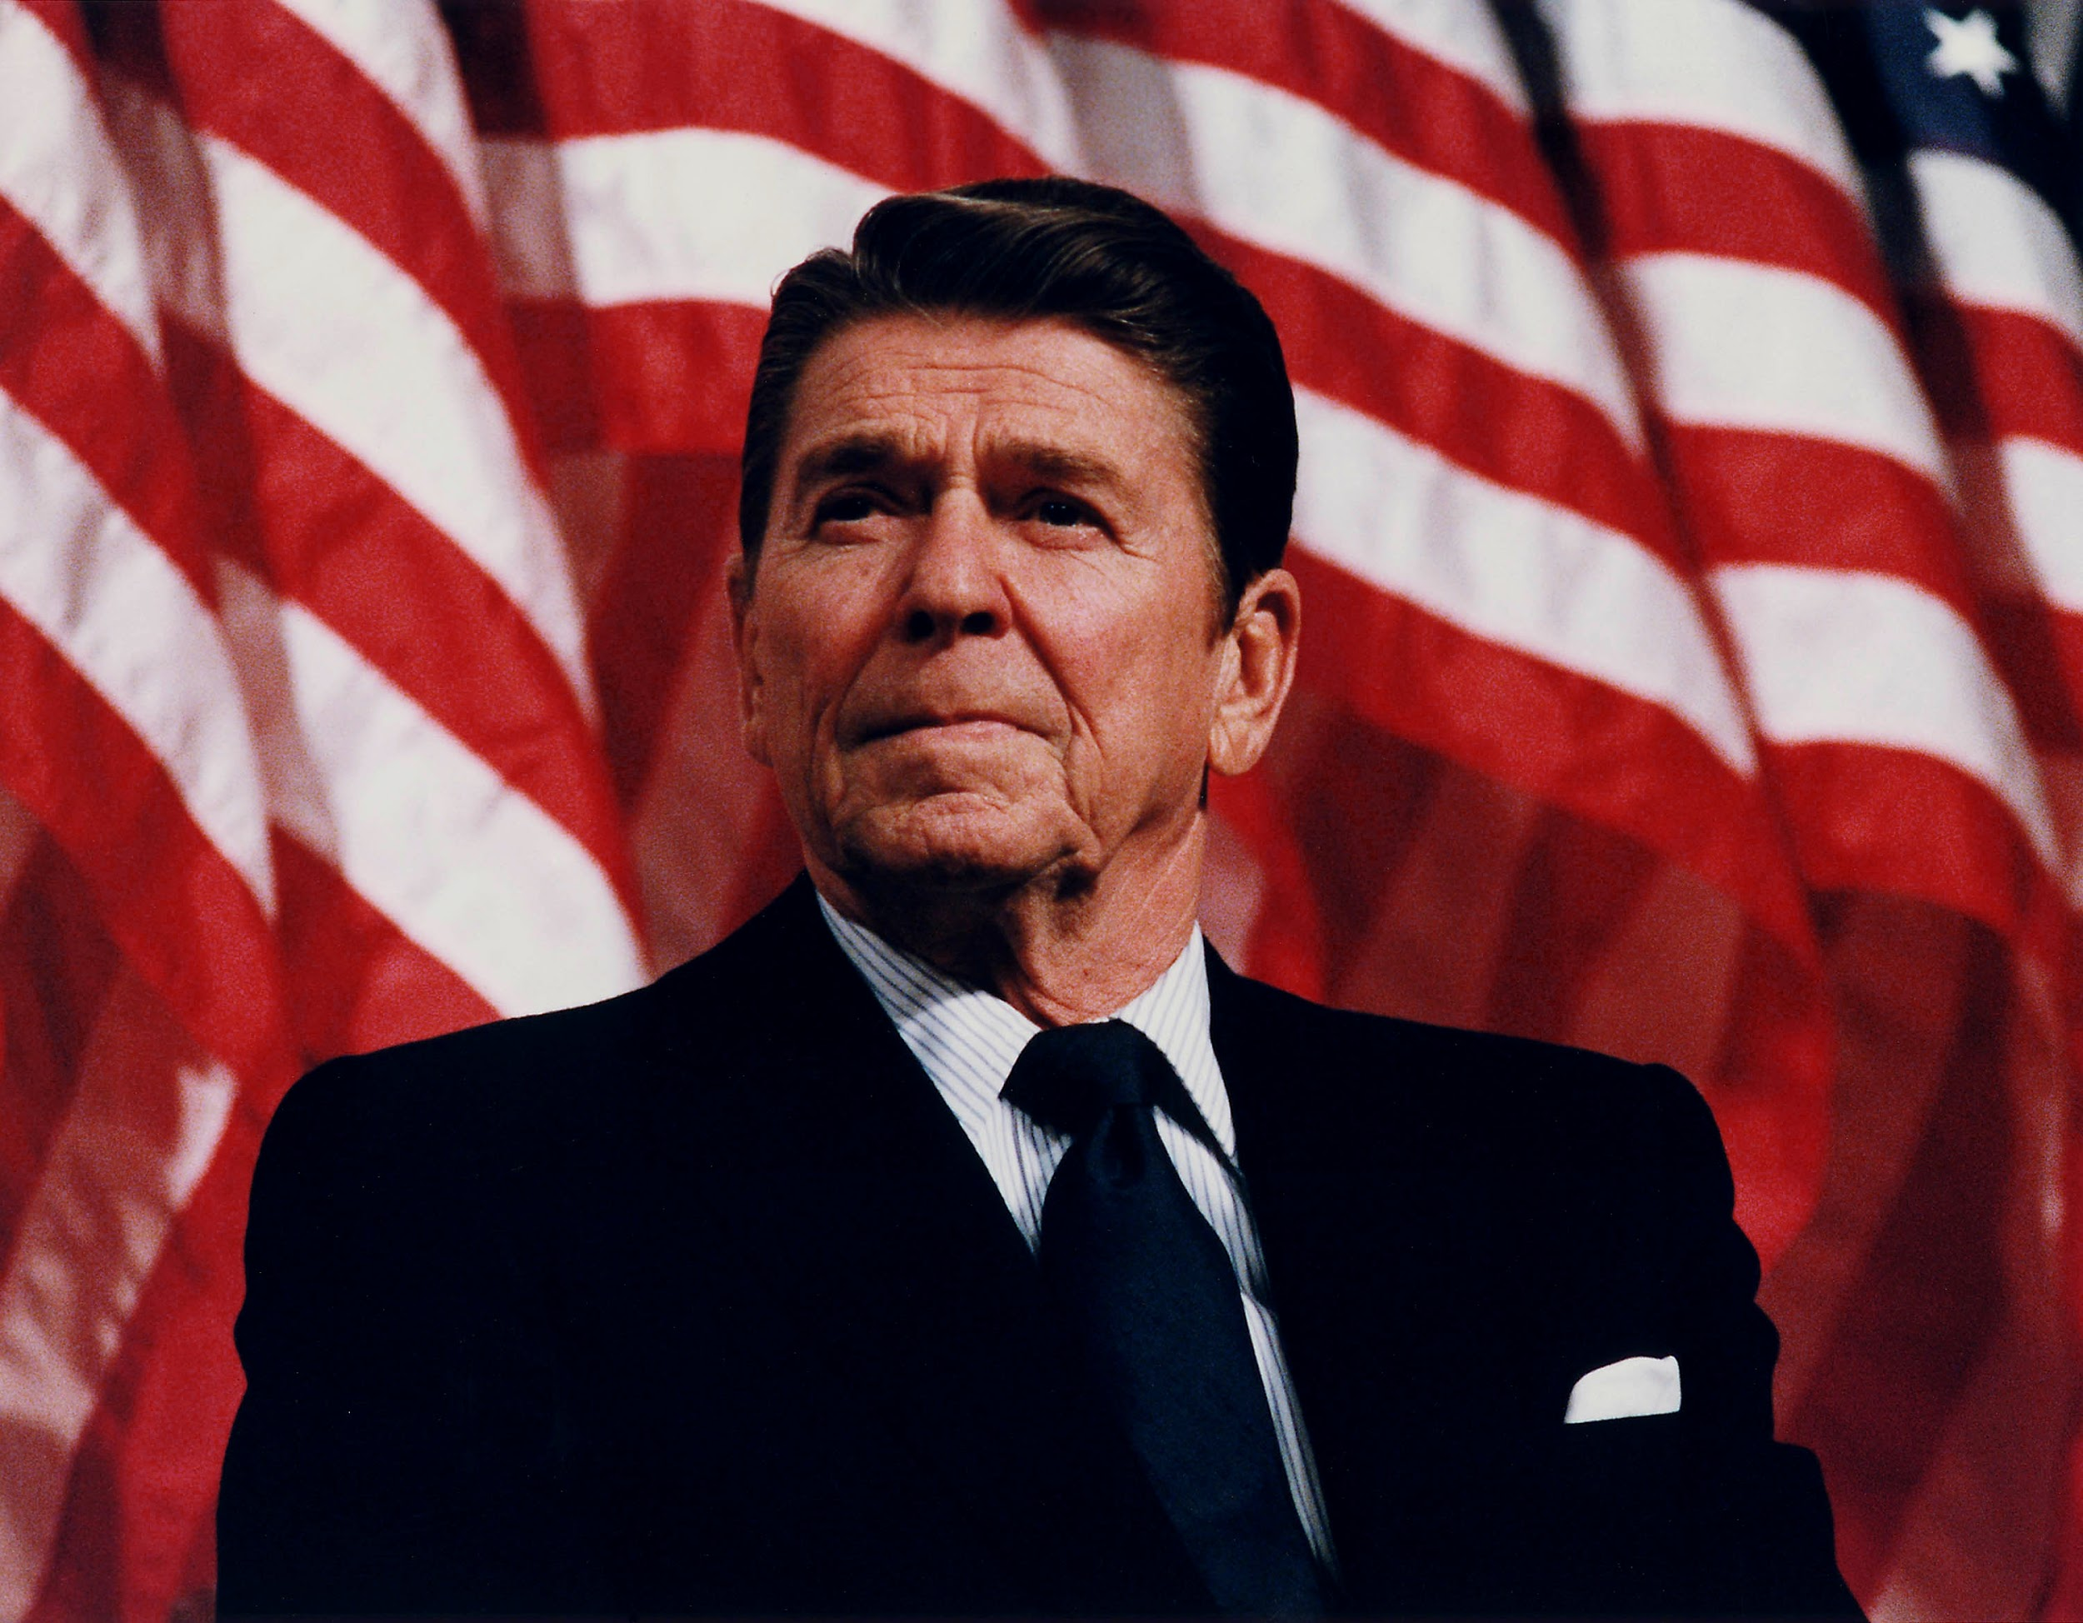
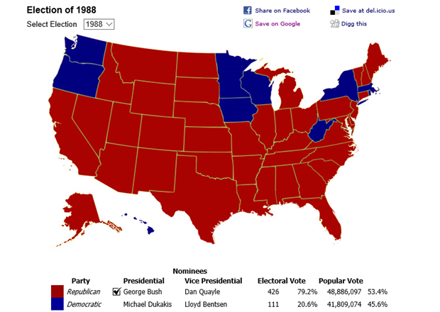
1980s
New right helps elect Ronald Reagan as president
  Conservative movement attracted many different groups of people
  Jimmy carter
Iran-Contra Scandal (1985-1987)
  Oliver North
  Secretive aid to anti-communist nations (contras)
George H.W. Bush elected president
  Defeated Democrat Michael Dukakis
  capitalized on a good economy, a stable international stage, and on Reagan's popularity

Slide 5
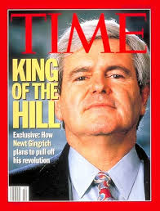
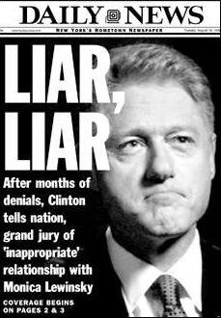
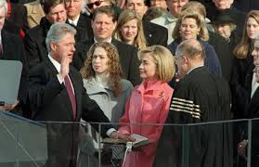
1990s
Bill Clinton, the failed Arkansas governor, adopted centrist policiesto get the Democratic nomination
  “American Renewal”
  “New Democrat”
Republicans gained control of both Houses of Congress
  Newt Gingrich
Welfare Reform Act
  Contract With America
  Republicans proposed a reform on Welfare. Clinton embraced this reform and proclaimed, “an end to welfare as we know it”
Impeached

Slide 6
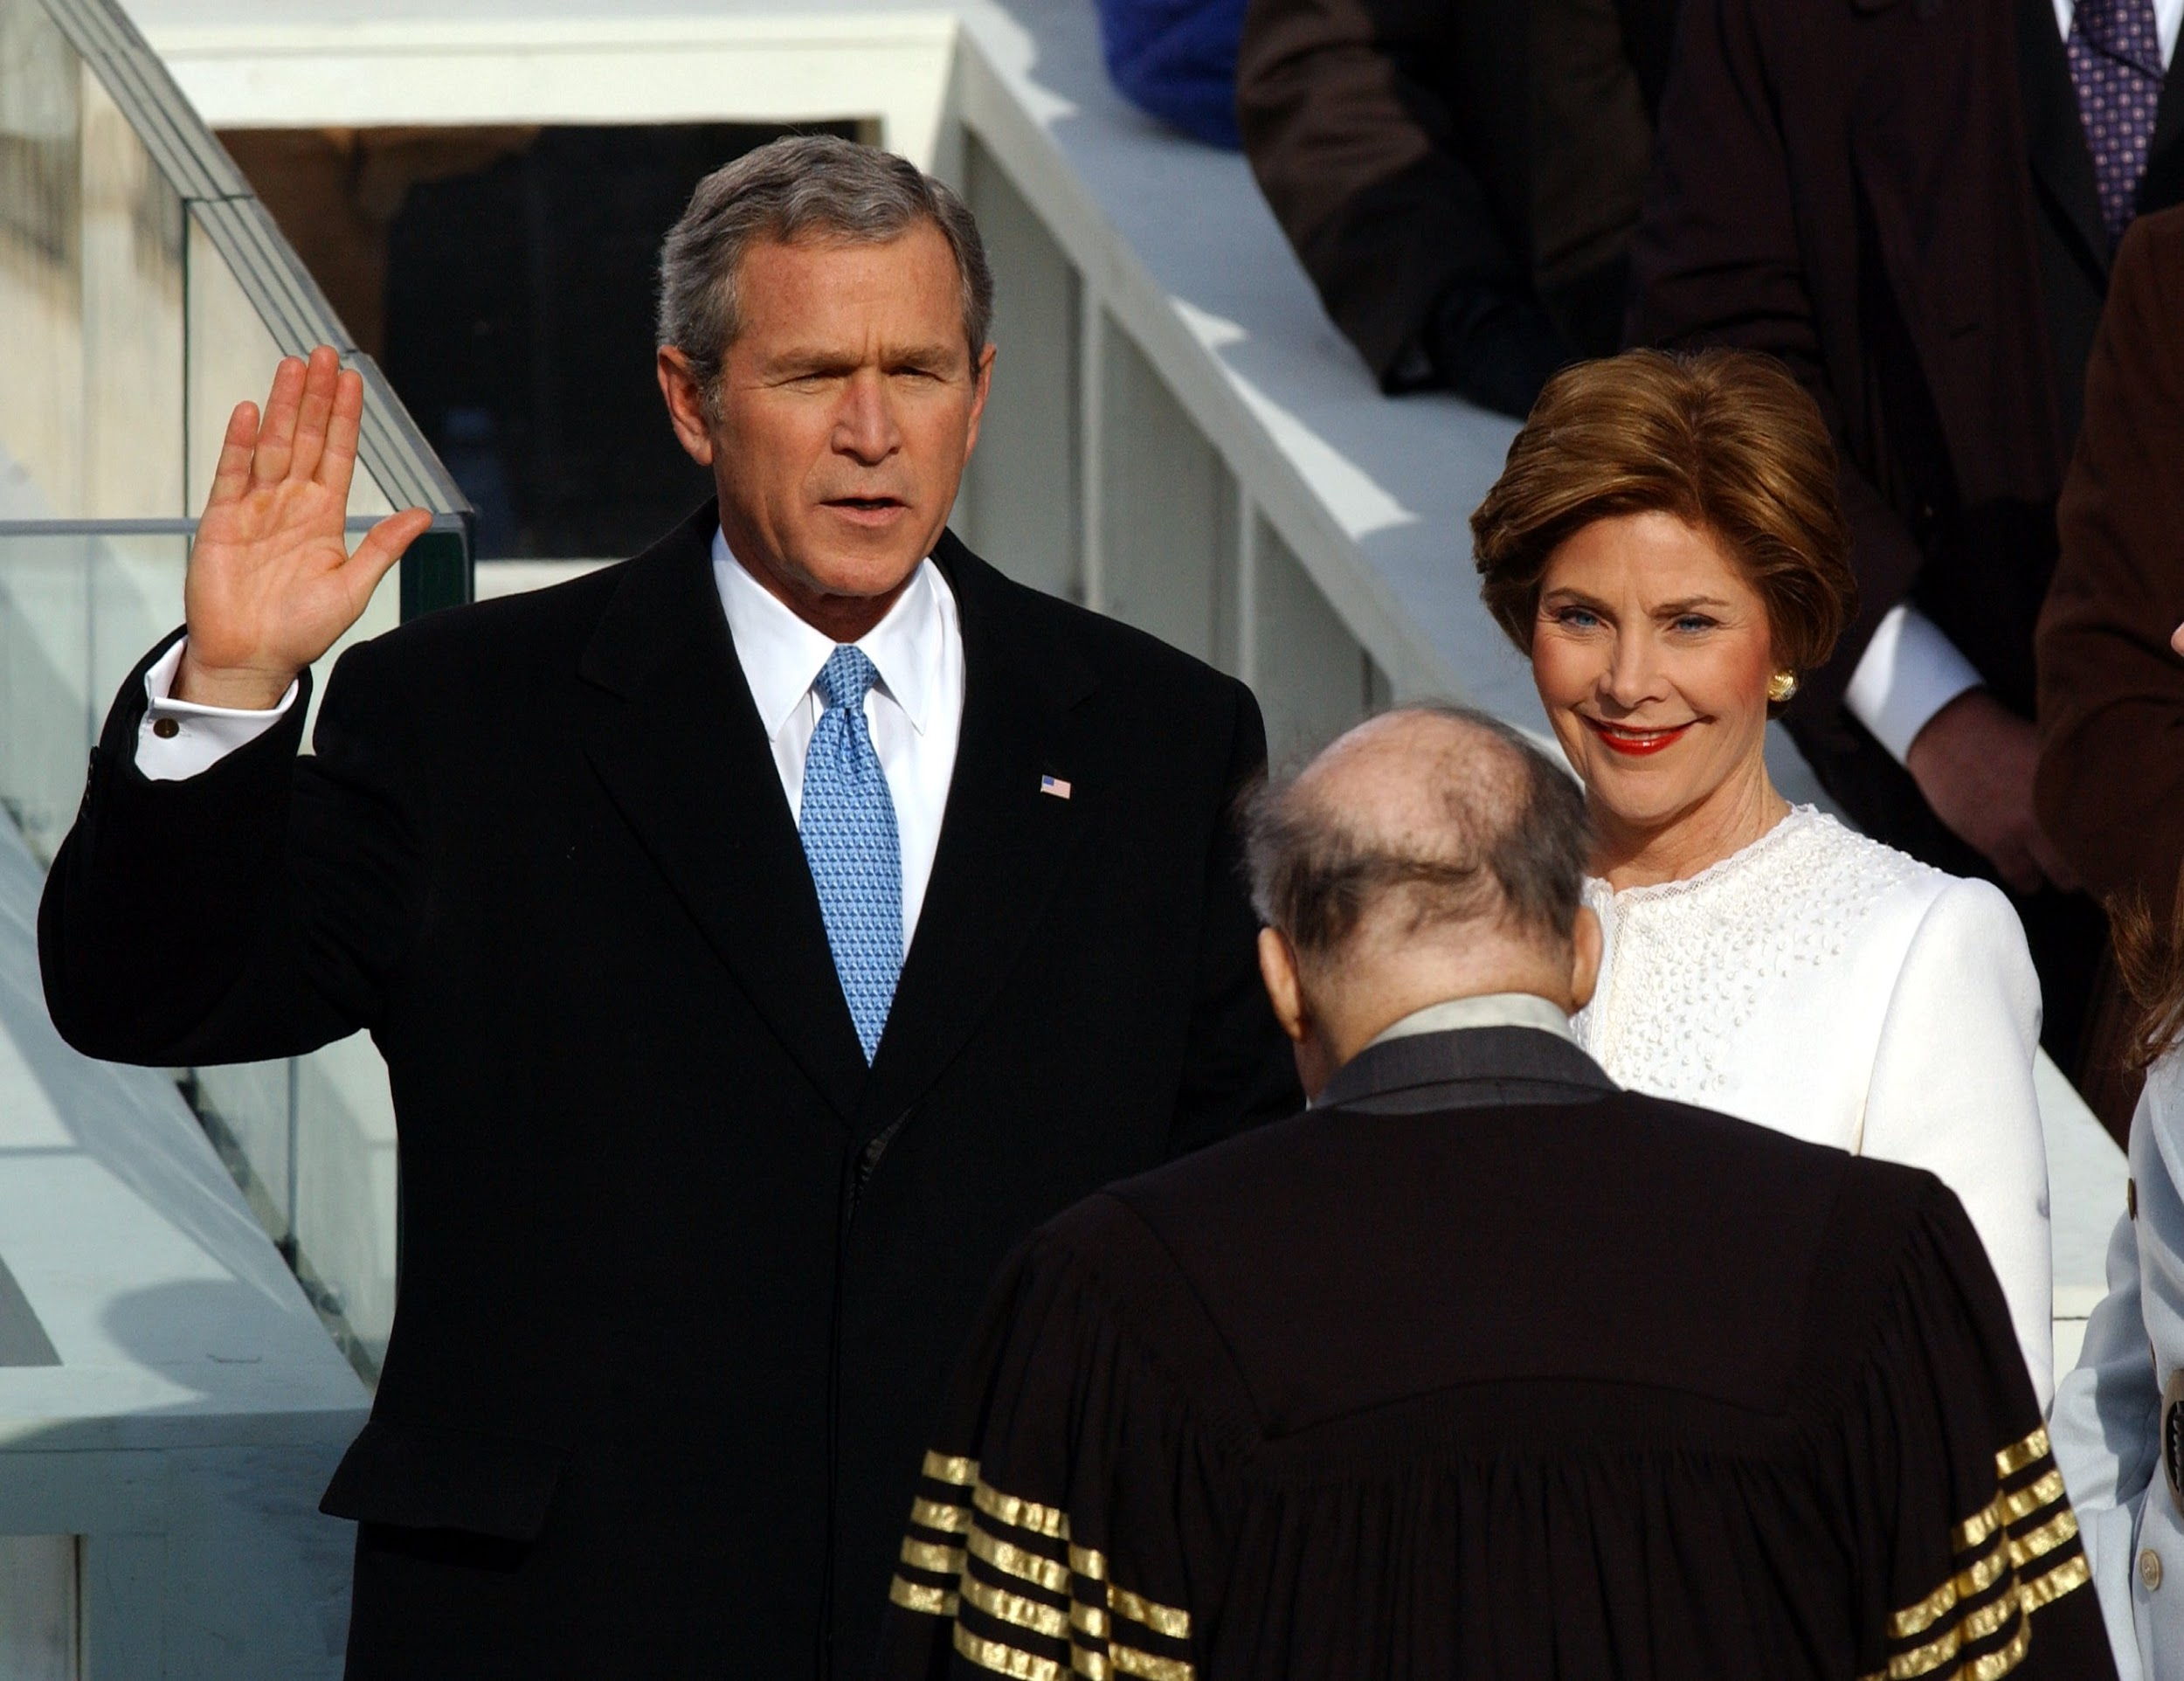

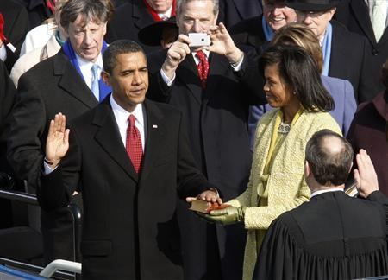
2000s
George W. Bush wins presidency in contested election (2000)
  Elected after a very close and controversial election
  Eight months into his administration the September 11, 2001 terror attacks occurred
USA PATRIOT Act (2002)
  Uniting and Strengthening America by Providing Appropriate Tools Required to Intercept and Obstruct Terrorism Act of 2001
  Expanded use of National Security Letters
Barack Obama elected first African American president (2008)
  Signed the PATRIOT Sunsets Extension Act of 2011
  Osama Bin Laden is killed under Obama Administration

Slide 7
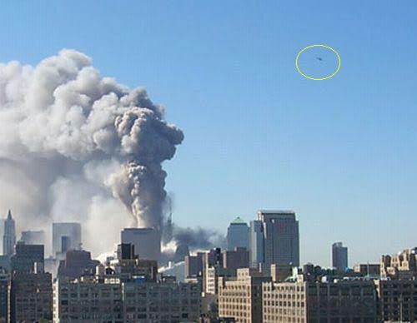
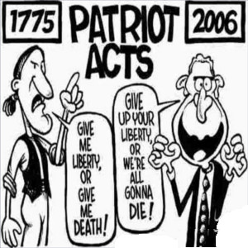

Trends of 2000
Caution and Paranoia
  Protecting United States citizens from further terrorists attacks
Outcome: Some felt that the procedures carried out to ensure safety violated their constitutional rights.

Slide 8


2010s
2010 - The Patient Protection and Affordable Care Act: Introduced a comprehensive system of mandated health insurance, intended to expand health care coverage to 32 million uninsured Americans and paid through by a Medicare Payroll tax expansion and other new taxes.
2010 - Resurgence of the conservative movement in the Tea Party
2012 - President Barack Obama narrowly wins re-election, aided by a well-executed turnout effort and support of minority voters, overcoming doubts about the performance of the economy.

Slide 9
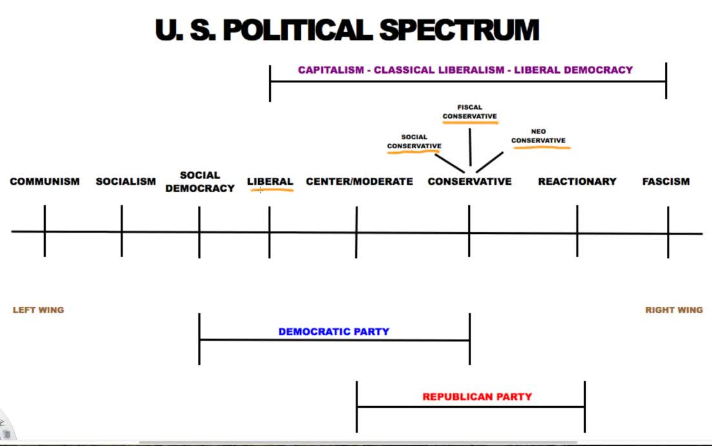

Slide 10
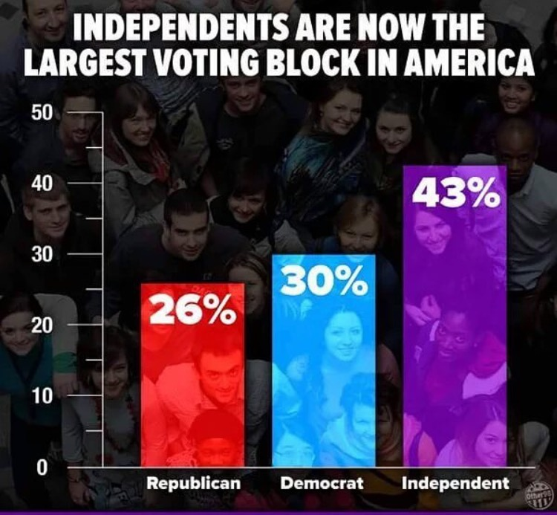

Slide 11
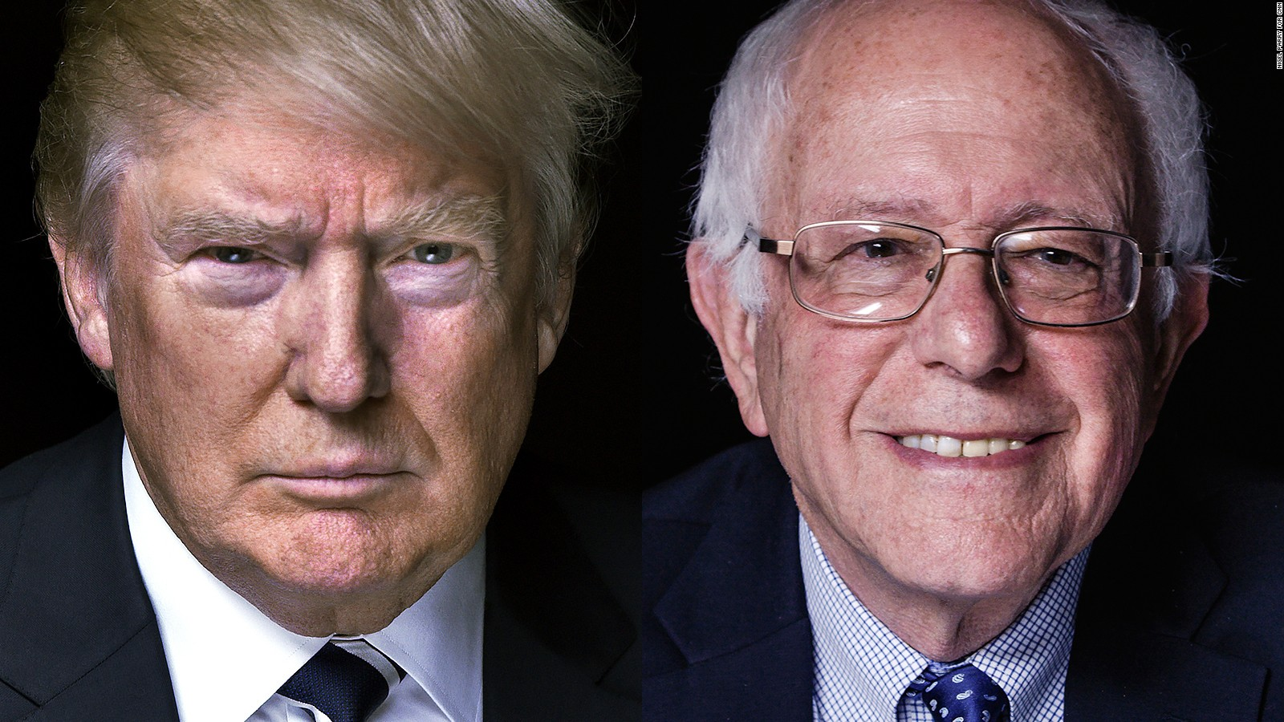


The Future of this Theme

